Slide 1
Efficient code flows,
Algorithms dance, precise,
Complexity tamed.

Slide 2
ADT Recap (ADTs are menus, not dinners)
List (alias Vector)
Set (alias Bag)
public interface List<E> {
void add(int index, E element);
E get(int index);
E remove(int index);
int size();
boolean isEmpty();
}
public interface Set<E> {
boolean add(E element);
boolean contains(E element);
boolean remove(E element);
int size();
boolean isEmpty();
}
Python: […,…,…]
Python: {…,…,…}

Slide 4
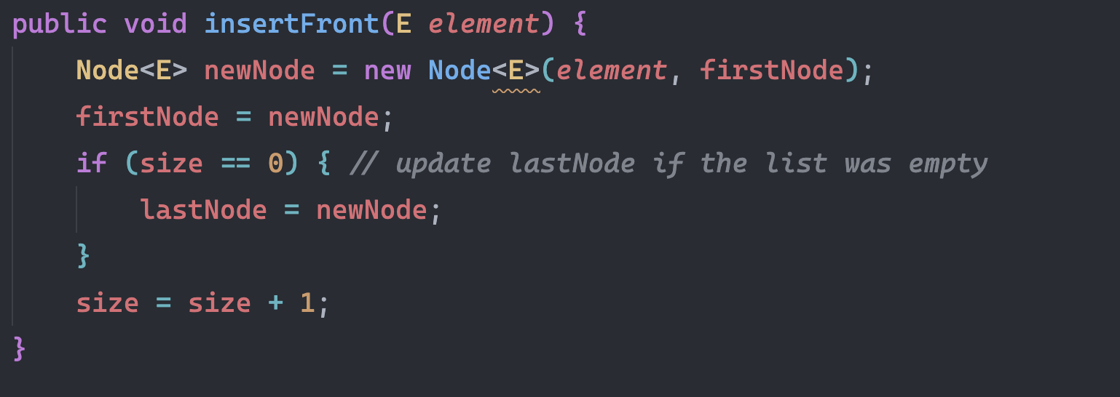
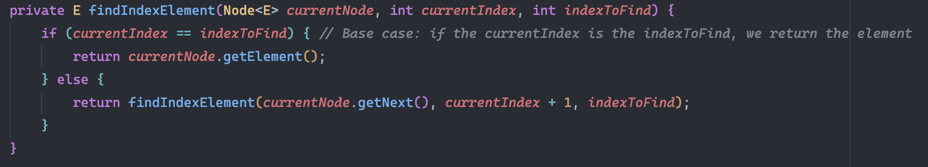
Head
NULL

Slide 5
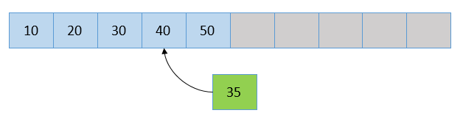
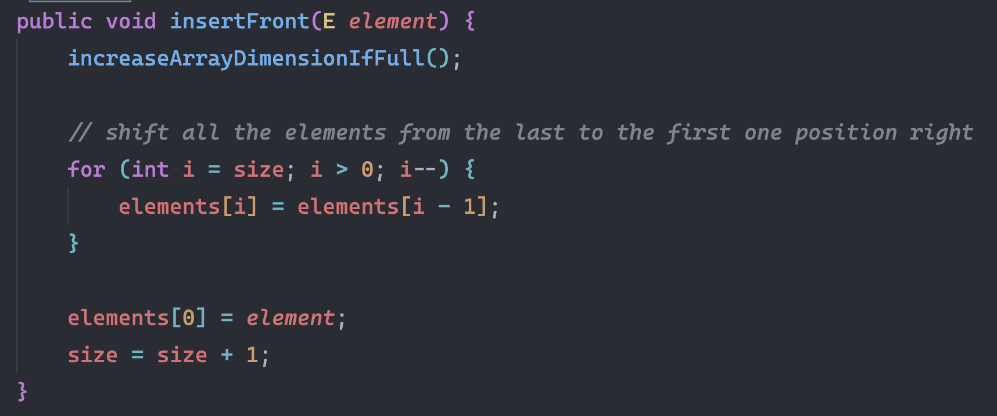

Slide 6
Find Max
6 | 14 | 7 | 4 | 9 | 3 | 1 | 3

Slide 7
Find 11
1 | 3 | 4 | 6 | 8 | 11 | 12 | 15 | 30
11 | 12 | 15 | 30
With each comparison, the interval size is halved.
After the 2nd comparison, n/4 elements remain, then n/8, etc.
The interval size becomes n/2^{k}
In the worst case we continue until n/2^{k} = 1
Solving n/2^{k} = 1 for k gives us k = log₂(n)
Hence binary search is O(log n)
11 | 12

Slide 8
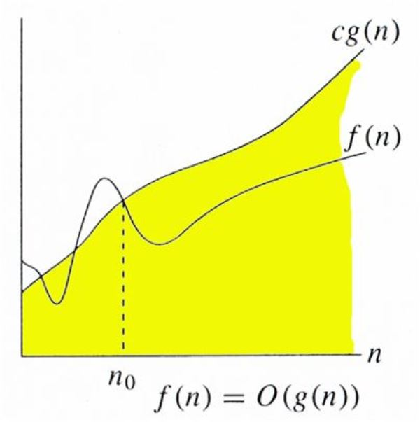
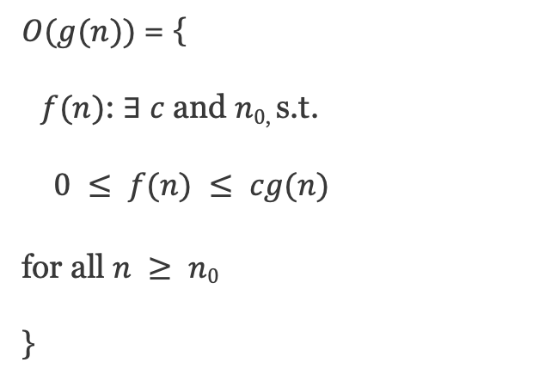
O
$O(g(n))$= {
$f(n)$: $∃ c$ and $n0$, s.t.
$0 ≤ f(n) ≤ cg(n)$
for all $n ≥ n0$
}

Slide 9
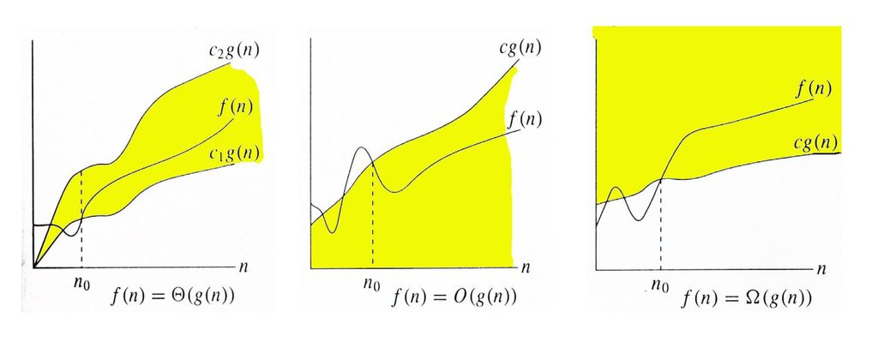
Θ / O / Ω

Slide 10
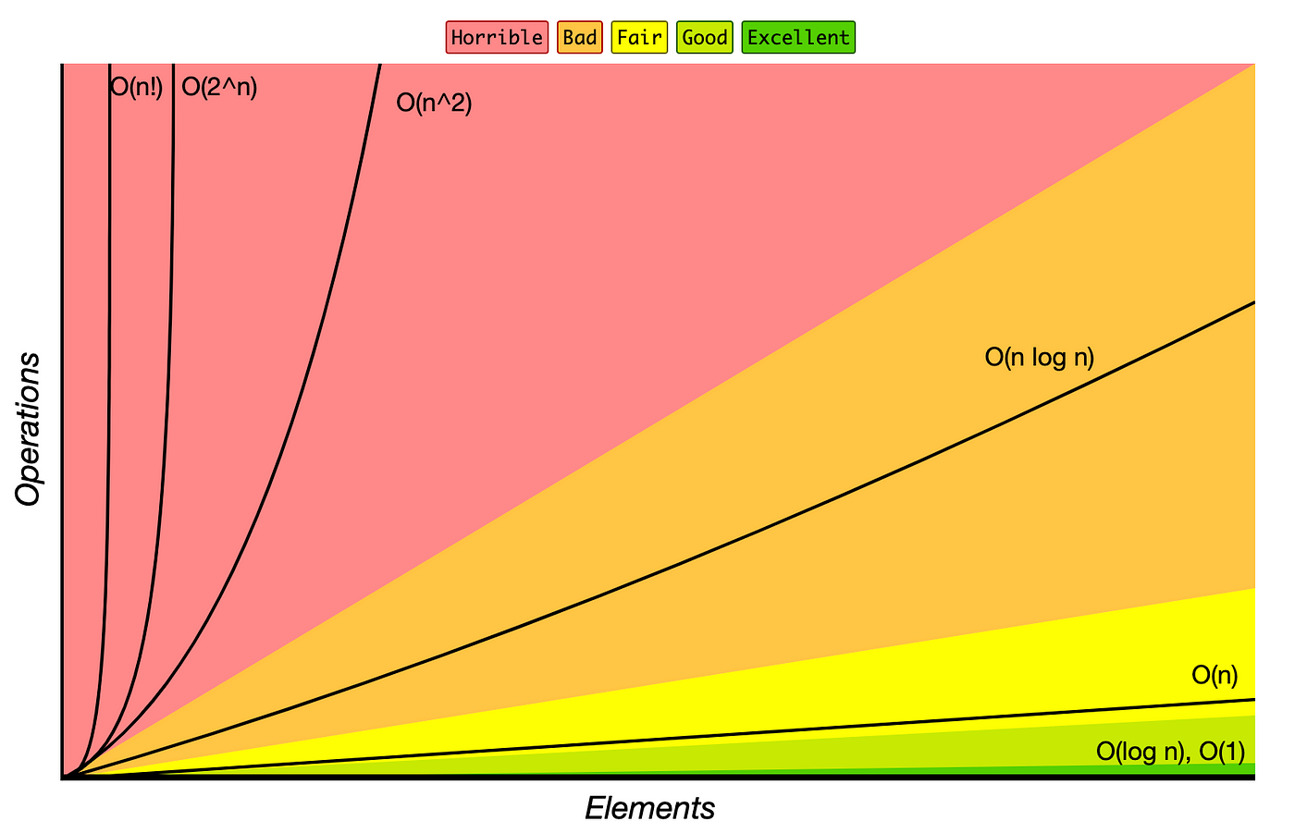

Slide 11
Common Complexity Classes
Class | Name | Examples
O(1) | Constant | Basic commands, Getting a value from an Array, adding an element to the front of a linked list.
O(log n) | Logarithmic | Typically seen in algorithms that break the problem in half every iteration. Such as Binary Search, finding an element in a balanced binary search tree.
O(n) | Linear | Searching for an element in an unsorted array, getting a value from a linked-list
O(n log n) | Log Linear | Efficient Sorting
O(n²) | Quadratic | Bubble sort, Nested iterations such as checking for duplicates
O(2^{n}) | Exponential | Recursive Branching problems, e.g. naive Fibonacci, naïve Travelling Salesman

Slide 12
 | Access | Search | Insertion | Deletion | Remarks
Linked List | O(n) | O(n) | O(1)* | O(1)* | * Assuming you have a reference to the insert/delete position (otherwise same as search)
Array List | O(1) | O(n) | O(n)* | O(n) | * Amortized O(1) for insertion at the end
Naive Unordered Set | - | O(n) | O(n)* | O(n) | Implemented as a simple array; checks for uniqueness on insert * Amortized O(1) for insertion at the end
Naive Ordered Set | - | O(log n) | O(n) | O(n) | Implemented as a sorted array
Linear Search | - | O(n) | - | - | Applicable to unsorted data; straightforward check of each element
Binary Search | - | O(log n) | - | - | Requires sorted data; not applicable for insertion/deletion without additional context

Slide 13
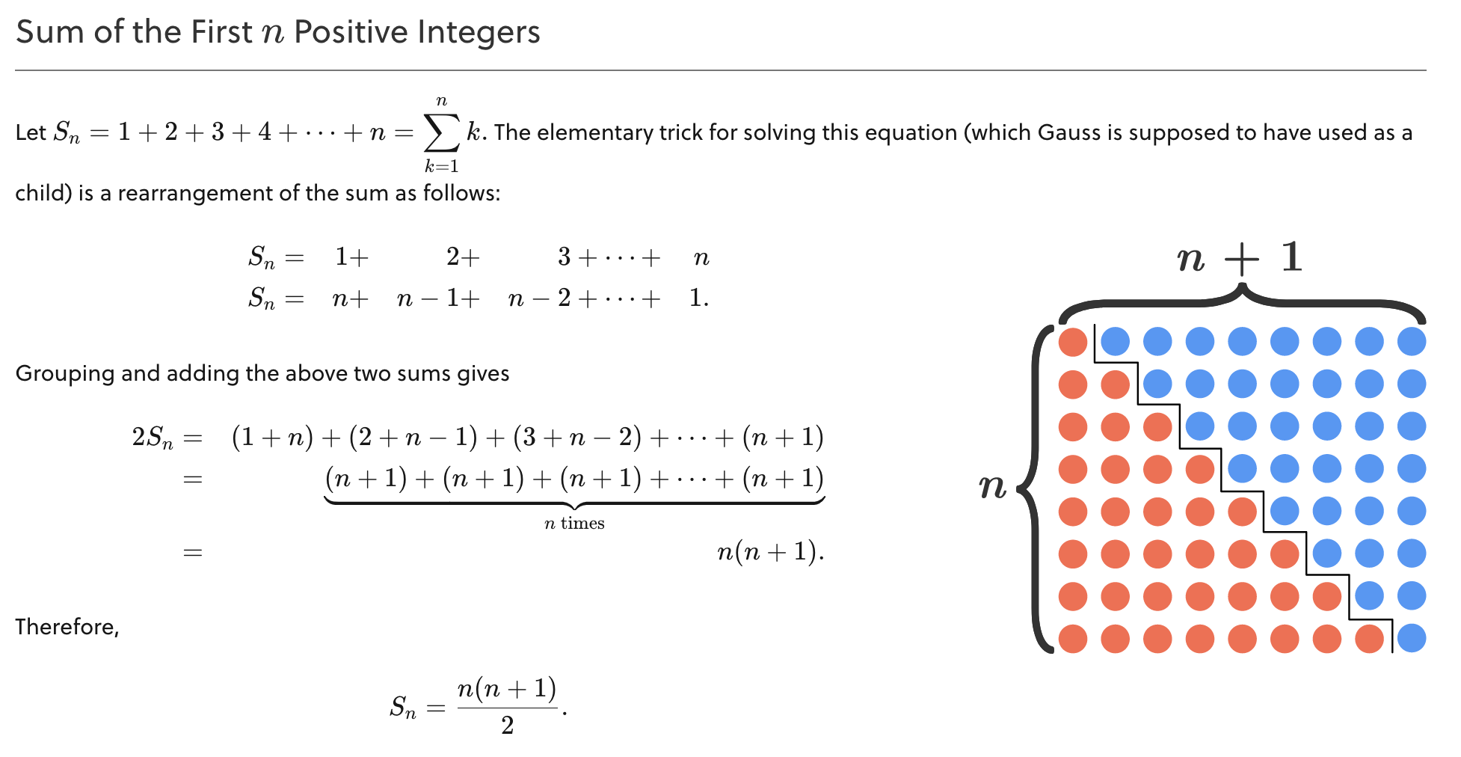
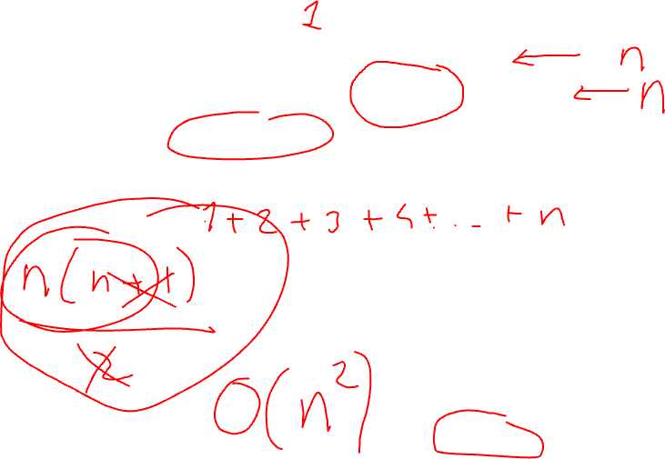
int sum = 0;
for (int i = 0; i < n; i++) {
for (int j = 0; j < i; j++) {
sum++;
}
}

Slide 14
Words in a map's world,
Collisions echo silence,
Dictionary's realm.

Slide 15
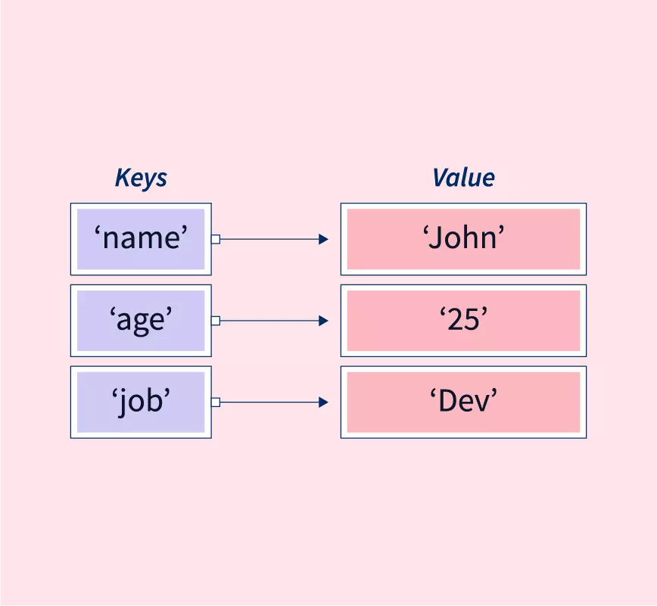

Slide 16
Dictionary ADT (alias Map/Table)
public interface Dictionary<K, V> {
// Associates the specified value with the specified key
void put(K key, V value);
// Returns the value to which the specified key is mapped
V get(K key);
// Removes the mapping for a key if it is present
V remove(K key);
// Checks if the dictionary contains a mapping for the specified key
boolean containsKey(K key);
// Returns the number of key-value mappings in the dictionary
int size();
// Checks if the dictionary is empty
boolean isEmpty();
}
Python: {key:value, …}

Slide 17
HashMap
Provide efficient data retrieval, insertion, and deletion operations by mapping keys to values using a hash function, achieving expected-case time complexity of O(1) for these operations.
It optimizes data access by minimizing the need for sequential search through keys, making it ideal for scenarios where quick lookup of information is critical.
Which data structure gives us O(1) access and what are its limits?

Slide 18
What is a Key?
How large can my keys get? How can they fit my array?
key-space > capacity

Slide 19
Hashing & Collision
mod (%) operator – remainder of division Result: constraining numbers within a specific range
h(x) = x % N
N = 8

Slide 20
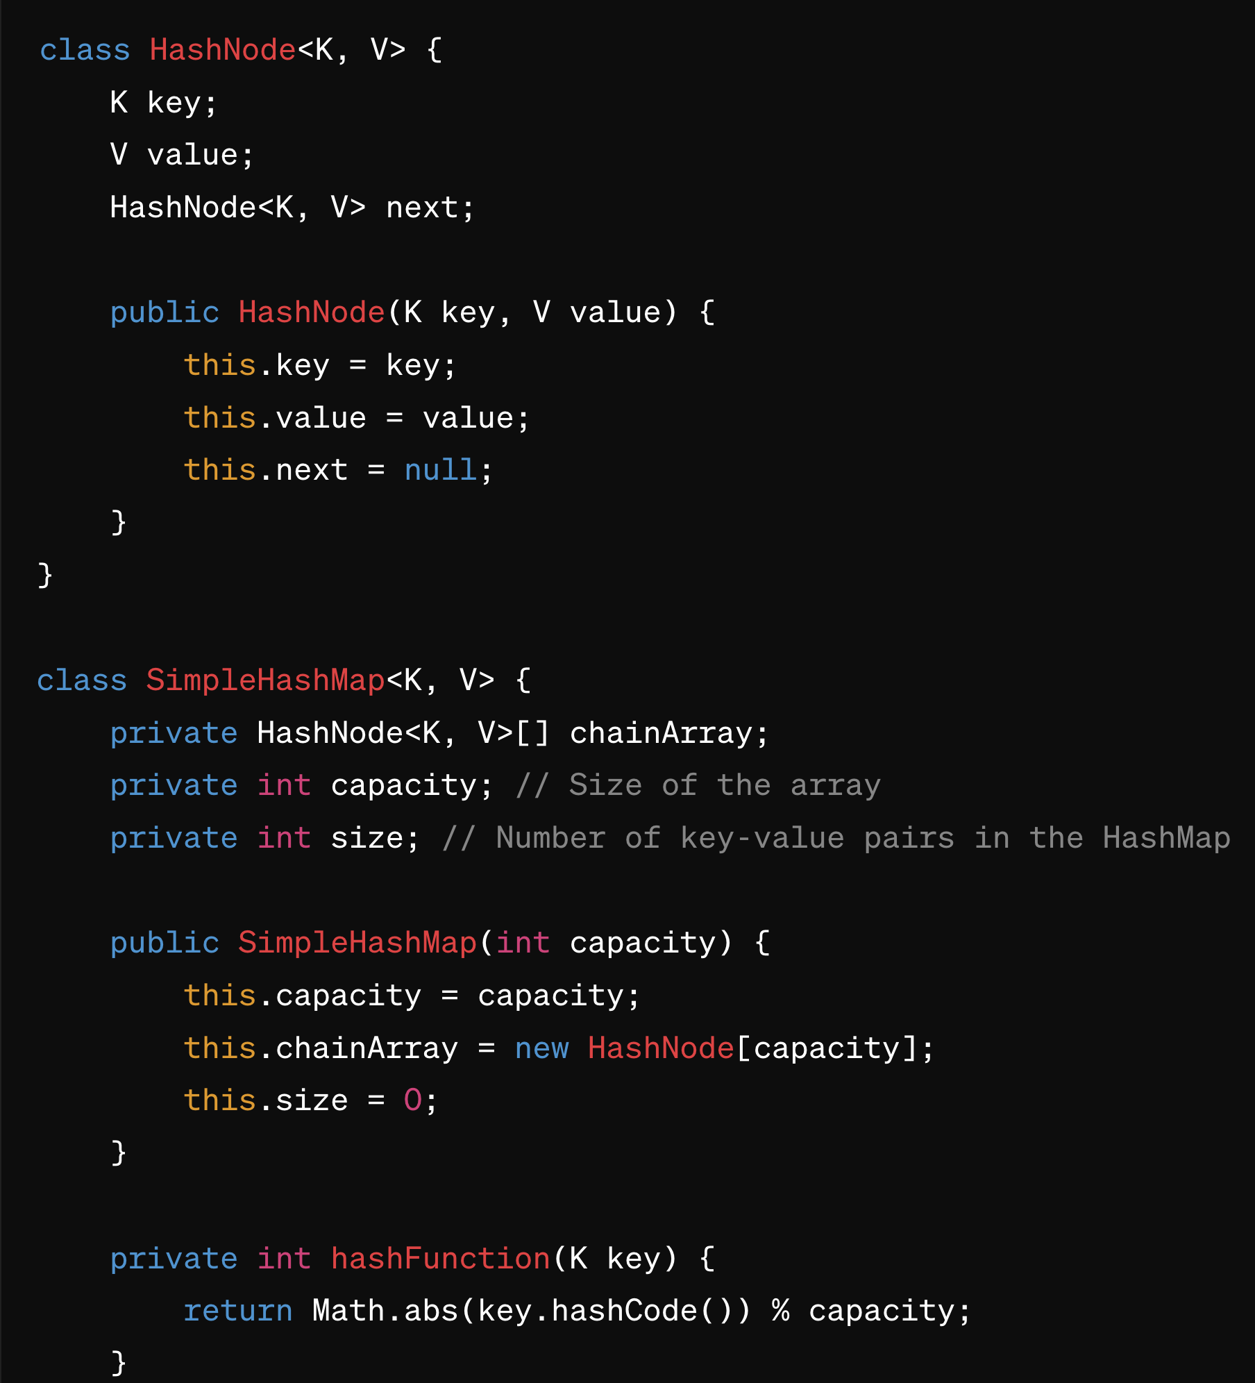
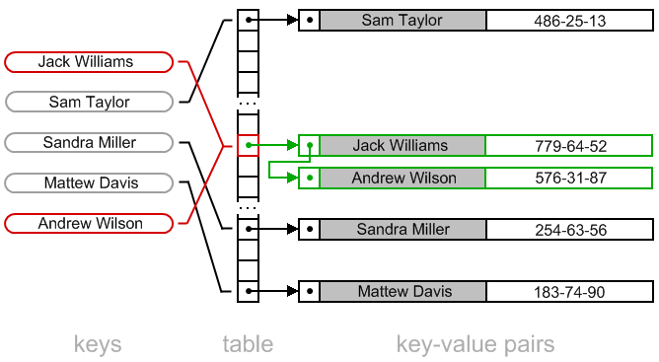
Separate Chaining

Slide 21
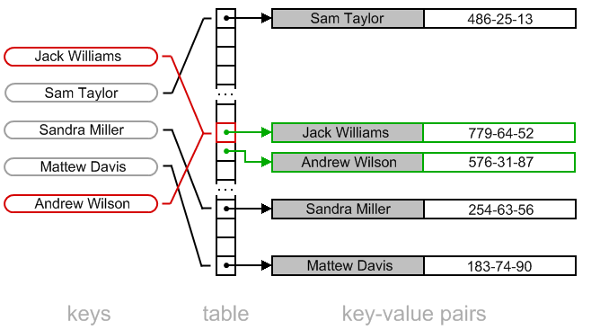
Open Addressing (Linear Probing)

Slide 22
Operation | Expected Case | Worst Case | Remarks
Insert | O(1) | O(n) | Worst case occurs when all keys hash to the same bucket.
Delete | O(1) | O(n) | Similar to insert, depends on the number of items in a bucket.
Search | O(1) | O(n) | Worst case occurs when searching for a non-existent key that hashes to a heavily populated bucket.

